Slide 1
Lecture 16 October 9,2019
Exam 2 Next Monday.
Problem set(s) posted later today.
Lab 3-4 due in lab Thursday---adopt a Drosophila culture/X-linkage begins in lab Thursday.
Topics list---Friday.
Busy times! Please make time to see me if you are having trouble keeping up. There is much assistance set up for your success! But YOU have to tap into it.
After exam 2---I rarely see major turn-arounds in struggling students. Please plan for success!

Slide 2
Help wanted
I could use a pair of students who could help with the first crosses of Drosophila---it requires collecting virgin females and special attention to timing and good observation skills.
Estimated 2-4 1-hour sessions of collecting female flies. Flexible times. Lots of instruction from me.
Email or drop by my office if interested.

Slide 3
https://www.nobelprize.org
It’s Nobel Prize week!!!
Prize in Medicine and Physiology-—3 scientists who study hypoxia. Low oxygen.
Nobel Prize in Physics—For discovery of first planet orbiting a star in a solar system outside our own.
Nobel Prize in Chemistry—for development of lithium-ion batteries. Thank them when recharging ANYTHING today.

Slide 4
Where were we?....
Molecular explanations for recessive and dominant traits (we looked at some human diseases)
Be able to give a general type of explanation—based on the central dogma.
AND
Hopefully you read more about the specific genes now known to be associated with Tay Sachs and Huntington diseases.

Slide 5
Moving on…
Chapter 4 reminds us that genetics gets a bit more complex than Mendel’s 1-gene, 2 allele, complete dominant/recessive traits.
For example…..

Slide 6
Some traits show incomplete or co-dominance
Some traits are controlled by single genes with 3 or more alleles in the population
Some traits are controlled by 2 or more genes
Some genes influence or stop the expression of others
Expression of some genes is highly dependent on nutritional factors or other environmental factors
Some traits have unique inheritance patterns that lead us to map the associated genes to sex chromosomes

Slide 7
Don’t confuse with sex-influence or sex-limited traits.
These are traits that differ in inheritance or are limited to being expressed in one sex.
IMPORTANT! Sex-linked traits can be seen in both sexes.

Slide 8
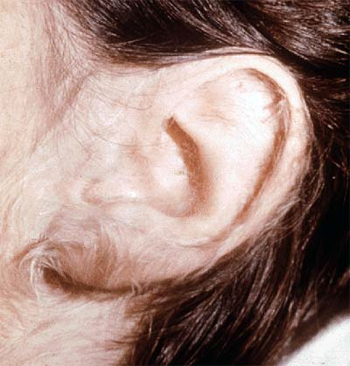
Start with a rare Y-linked trait. (So few genes on Y that these traits are rarely noted.)
“hairy ear” trait has been mapped to a gene on the Y chromosome.

Slide 9
For example---hairy ears

Slide 10
X-linked traits
Much more common than Y-linked traits (many more genes on X)
First recognized in Drosophila by Thomas Morgan
Noted different outcomes in reciprocal crosses (different out comes, swithing the male and female parents with respect to traits.
Noted that the white eye trait was inherited in a sex-linked way---concluded that the white mutation was in a gene on the X-chromosome

Slide 11
To study, you must track both the trait and the sex of the organism showing the trait.
Let’s review Drosophila eye color. White eyes is a recessive trait. The dominant color is red.
The inheritance of white eyes looks different from the autosomal recessive traits we’ve seen so far---depending on how the cross is setup AND if you pay attention to the sex of the offspring.

Slide 12
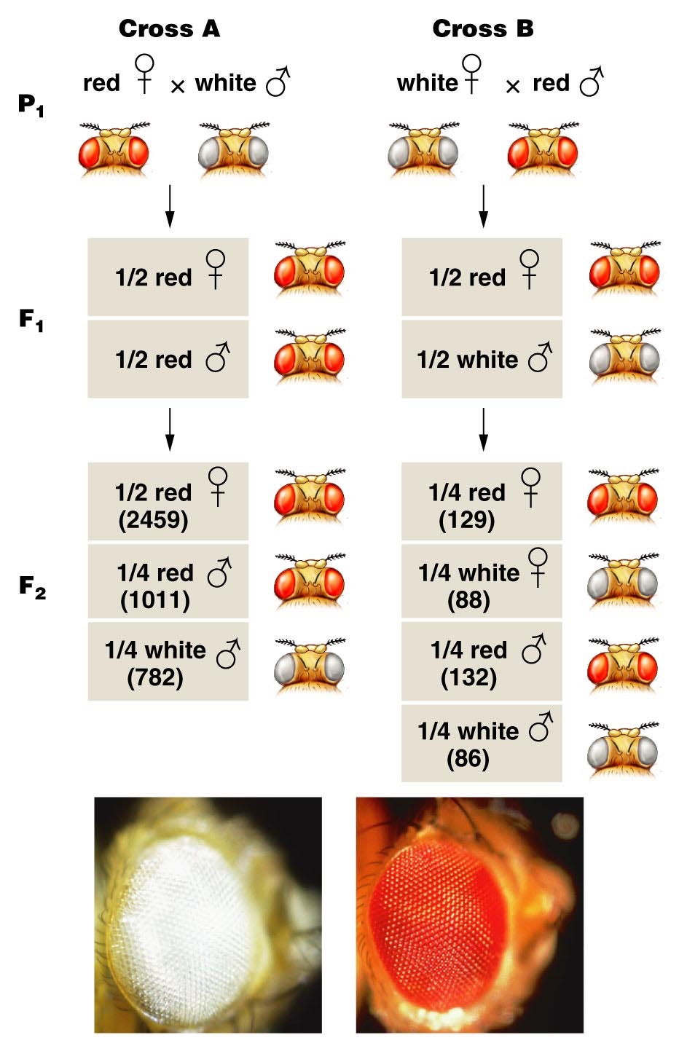
Unlike Mendel, Morgan noted differences in reciprocal crosses
F1 shows both parental traits
3:1 but only males have white eyes
F2 shows 1:1 ratio
Figure 4.12
Notes:
Figure 4-12 The F¹ and F² results of T. H. Morgan’s reciprocal crosses involving the X-linked white mutation in Drosophila melanogaster. The actual data are shown in parentheses. The photographs show white eye and the brick-red wild-type eye color.

Slide 13
Morgan proposed, that the gene controlling eye color was sex-linked. The fact that only males had white eyes in the F1 of cross A suggested X-linked. (This may seem counterintuitive at first---hang on…)
He tried the following scheme to explain the unexpected pattern of inheritance.

Slide 14
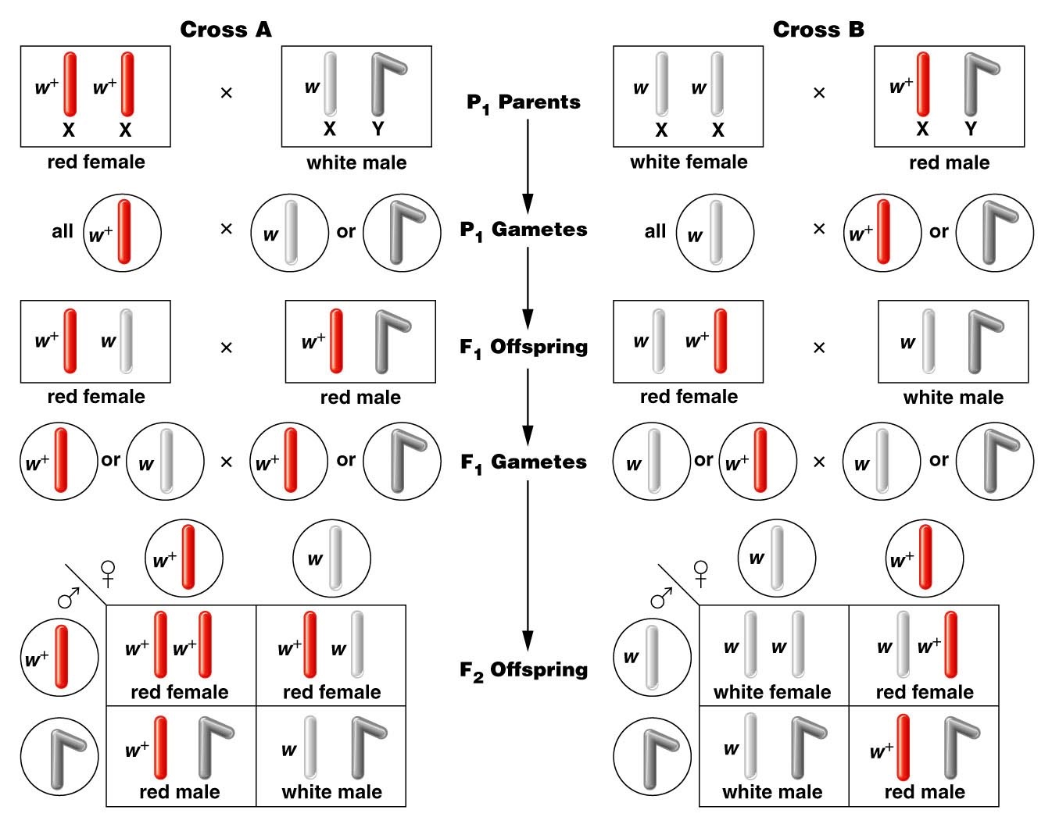
Figure 4.13
Notes:
Figure 4-13 The chromosomal explanation of the results of the X-linked crosses shown in Figure 4–11.

Slide 15
Figure 4.13
Notes:
Figure 4-13 The chromosomal explanation of the results of the X-linked crosses shown in Figure 4–11.

Slide 16
The hypothesis that the w (white) allele was located on the X chromosome, is consistent with patterns of inheritance in both reciprocal crosses.
Sex-linkage is just one of the extensions to Mendel’s observations we have discovered while studying inheritance.

Slide 17
Extension #2
Incomplete or partial dominance. A few traits are controlled by genes for which neither allele is completely dominant.
We see intermediate forms of the trait in F1 heterozygote.
Predictable ratios in F2
e.g. Snapdragon color inheritance (on board)

Slide 18
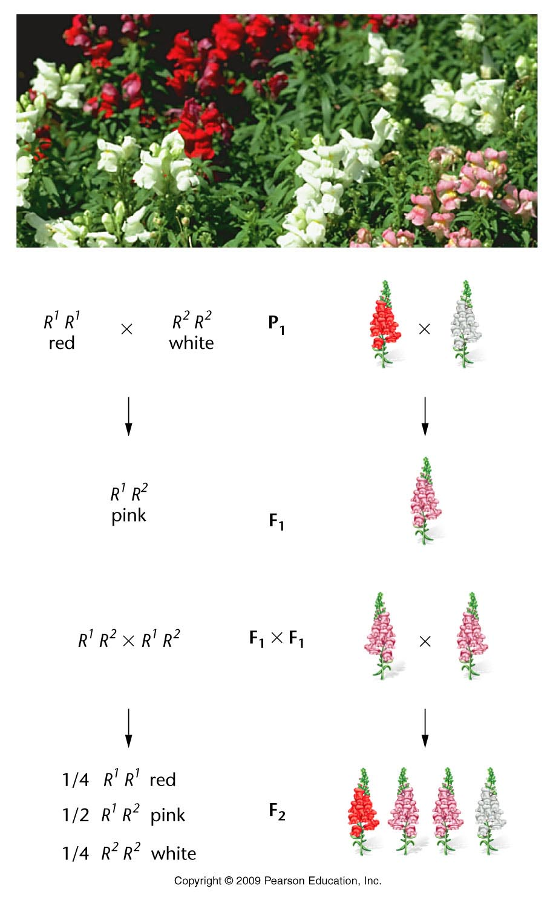
F1 is different than either parent
1:2:1---looks familiar?
Figure 4.1
Notes:
Figure 4-1 Incomplete dominance shown in the flower color of snapdragons.

Slide 19
Molecular explanation?...
C^{r}C^{w} is pink why?
In nature, white is usually due to a lack of pigment rather than production of something white.
C^{r}C^{r} is red (both color alleles produce red pigment protein)
C^{w}C^{w} is white (neither color allele is functional)
C^{r}C^{w} is pink (one color allele is functional, half as much red pigment made)

Slide 20
In this case the traits show a “dose effect” or a “threshold effect”
2 red alleles looks red: 1 red allele looks pink: 0 red alleles looks white

Slide 21
Extension #3
Co-dominance
For some traits, heterozygotes express different alleles equally

Slide 22
Co-dominance
e.g. Several molecules found on red blood cells show co-dominant expression (on board)
MN blood group 2. ABO blood group
(Both referred to as cell surface antigens)

Slide 23
Important terminology
Cell surface molecules are often referred to as antigens, if they can be bound/detected by specific antibodies.
Antibodies can be used to detect antigens we cannot see with eye directly.
antibody
Antigen

Slide 24
Agglutination (in vitro assay---outside of the organism)

Slide 25
ABO blood group antigens
Antigen used commonly to determine common “ blood type”
Example of 2 extensions of Mendel’s observations.
1. Co-dominance (and complete dominance)
2. Trait controlled by a gene with 3 alleles in the population. Gene is called isoagglutinogen gene.

Slide 26
Summarize Genotypes and Phenotypes
Genotype Gene product Phenotype/Blood type
I^{A}I^{A} A sugar/antigen A
I^{A}I^{O} A sugar/antigen A
I^{B}I^{B} B sugar/antigen B
I^{B}I^{O} B sugar/antigen B
I^{A}I^{B} A and B sugar/antigen AB
I^{O}I^{O} neither A nor B sugar/antigen O

Slide 27
Test your understanding. What type of offspring are possible? What are theoretical expectations? Do this! Practice! Show Punnett square!
AXA
B X B
A X B
O X O
AB X AB
A X O
B X O
A X AB
B X AB
O X AB
Set up your punnett square in ways that test all possibilities of genotypes.

Slide 28
Practical application?...
Blood type is often used to determine if an individual could be the parent of a child.
e.g. Paternity cases, babies switched in hospital
Can only rule out an individual as a parent, not prove that he/she is. Why?

Slide 29
Why do we care about ABO blood group?
Until medical technology advanced to allow blood transfusions, we didn’t care, because hadn’t detected them yet.
But…During the first transfusions, ABO antigens were actually discovered because agglutination occurred in the recipient of the donated blood cell. Agglutination in vivo is fatal.

Slide 30
So…what happened?
Some immunology background….Usually white blood cells called B-cells produce antibodies only after something foreign enters our bodies---like a virus.
Antibodies are very specific and bind the foreign antigen to inactivate it.

Slide 31
In fact, we coaxed mice into making the antibodies against human A- , B-, and D-antigen to use in our lab. The antigens are foreign to mice so they make antibodies—as if they are being attacked by a pathogen.
We can then just take the serum from these mice and use it in ABO blood typing.

Slide 32
But why would humans have these antibodies in their serum.
Unusual phenomenon. Humans make anti-A and anti-B antibodies without known prior exposure to the antigens.
Cause rbcs to agglutinate (clump together)
Fatal in blood transfusions with incompatible blood types

Slide 33
Summary of all blood types
Blood type rbc antigen antibody produced result as transfusion recipient
A A anti-B agglutinates B RBCs
B B anti-A agglutinates A RBCs
AB A and B none no agglutination
O no A nor B anti-A and anti-B agglutinates A, B, AB RBCs

Slide 34
Blood type compatibility---practice!
Must consider 2 things before blood transfusions
Which, if any antigens are on the rbcs of the donor? (Donor only gives cells)
Which, if any antibodies will be present in the recipient's serum. (donors cells will combine with the recipient’s serum)

Slide 35
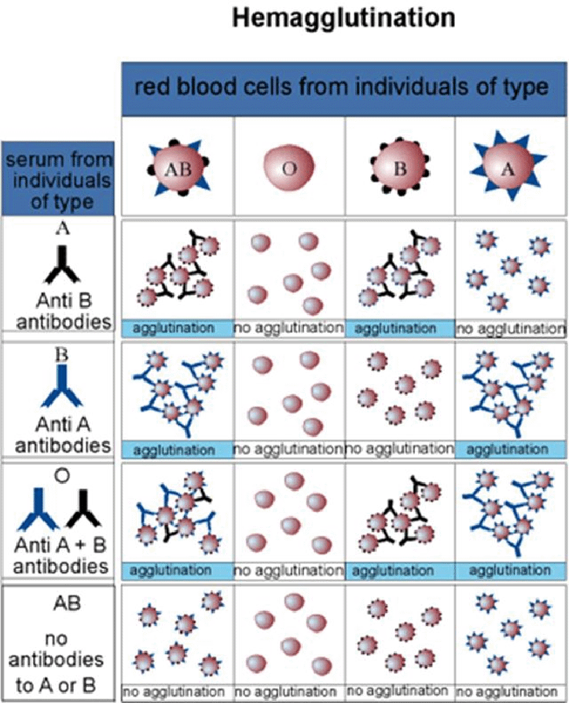

Slide 36
Try the blood typing game at: Nobelprize.org
http://www.nobelprize.org/educational/medicine/bloodtypinggame/

Slide 37
Other important rbc antigens…
Another antigen, called D-antigen/rhesus factor/Rh factor is present on rbcs
Controlled by other genes (not I-gene)
Some people express Rh antigen on rbcs (Rh-positive), some lack the antigen (Rh-negative)
Important in women during pregnancy
Fatal condition for fetus in cases of Rh incompatibility

Slide 38
Rh incompatibility
Rh-negative mother conceives an Rh-positive child.
Normally blood from fetus and mother never comes in direct contact because of the placenta
At birth, however, placenta often ruptures and fetal rbcs may enter the mother’s circulation
Mother, who lacks Rh antigen sees it as “foreign” and begins to make anti Rh-antibodies. These antibodies can lyse/destroy rbcs with Rh antigen on them.

Slide 39
No problem?...
The baby is born…no problem for that baby.
Subsequent pregnancies---Rh+ fetuses will produce rbcs with Rh antigen. Mother will now have ability to make antibodies and destroy these cells.
Hemolytic anemia of the newborn. Fatal.

Slide 40
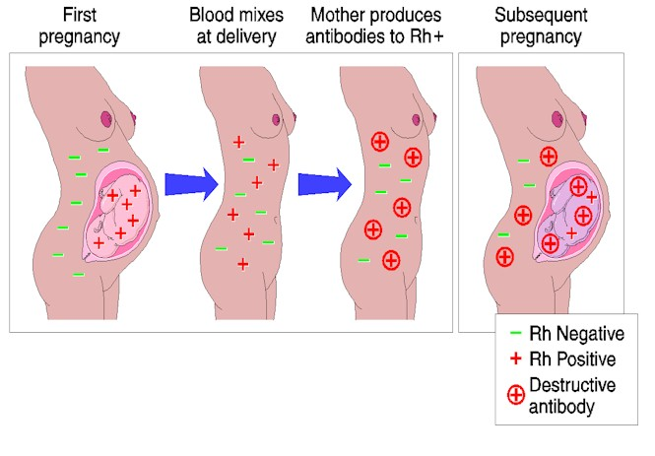

Slide 41
Solution?...
Now can give Rh- mother a substance Rhogam that lyses and destroys any Rh+ fetal cells from the baby before mother can mount her own antibody response.
What is the substance? Dose of anti-Rh antibodies. Seek out baby’s cells and destroy, but do not last long enough to affect a second pregnancy.

Slide 42
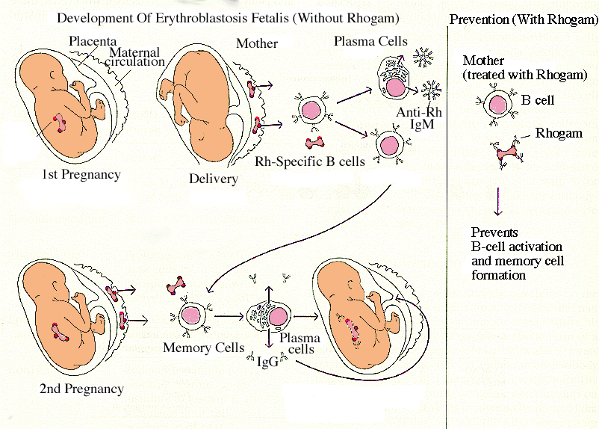
Destroys fetal cells before Mother’s B-cells are activated and begin making antibodies

